Slide 1


Strathaven Academy
Emergency Evacuation Plan 2025
Contents:
Slide 1 – Roles and responsibilities of pupils, registration/tutor staff, ELT staff, all other teaching staff
Slide 2 – Muster points for all pupils (where you should report to depending of your year group)
Slide 3 – Map of the cage (S1 – S4) muster point – where each class should line up once on the cage
Slide 4 – Map of the S5 and S6 muster points – where each class should line up

Slide 2
STRATHAVEN ACADEMY
EMERGENCY EVACUATION PLAN RESPONSIBILITIES
SLIDE 1
Pupils
Leave all belongings behind
Follow class teacher instructions to exit the building
Walk calmly to the muster point to meet your registration class
Stand in alphabetical order in pairs in a straight line
Behave in an orderly manner in line with school rules
Register / Tutor Teachers
Leave all belongings behind
If teaching, instruct your class where to exit the building
Walk calmly to meet register class at their muster point
Complete register for class, and hand back to designated staff
Remain with your class to ensure pupils behave appropriately
ELT Members
Leave all belongings behind
Completed assigned duty for exiting the building
Walk calmly to the muster point & report to your assigned area
Complete designated task as outlined in school policy
Provide support to help manage pupil behaviour in your area
All other Teaching Staff
Leave all belongings behind
If teaching, instruct your class where to exit the building
Walk calmly to muster point outside the cage at picnic bench
Be on hand to cover a duty for an absent member of staff
Provide support to colleagues managing pupil behaviour
Pupils and staff should remain at their muster point until given the all-clear to return to the building by SLT

Slide 3
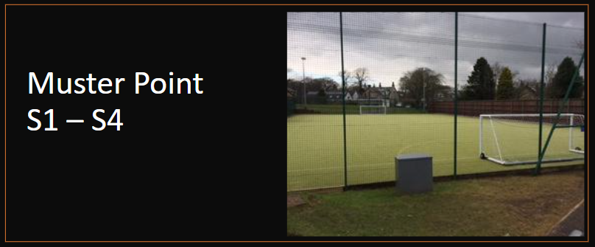
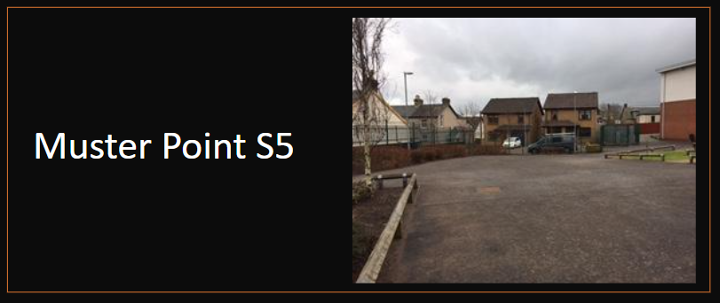
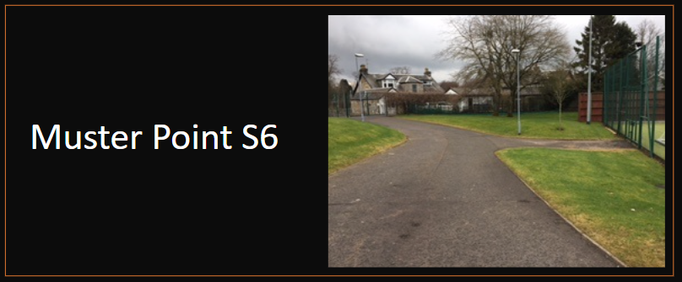
SLIDE 2
Pupil Muster Points
When an Emergency Evacuation Alarm Sounds, pupils will be informed by their teacher to:
Stop what they are doing
Leave their belongings
Listen carefully to all instructions
Remain calm and quiet
Use the nearest fire exit
Walk carefully out of the building to their assigned muster point
S1, S2, S3 and S4 pupils should report to the cage for their muster point
S5 pupils should report to the tarmac area next to the Crawford Street gates
S6 pupils should report to the tarmac area outside the far end of the cage

Slide 4
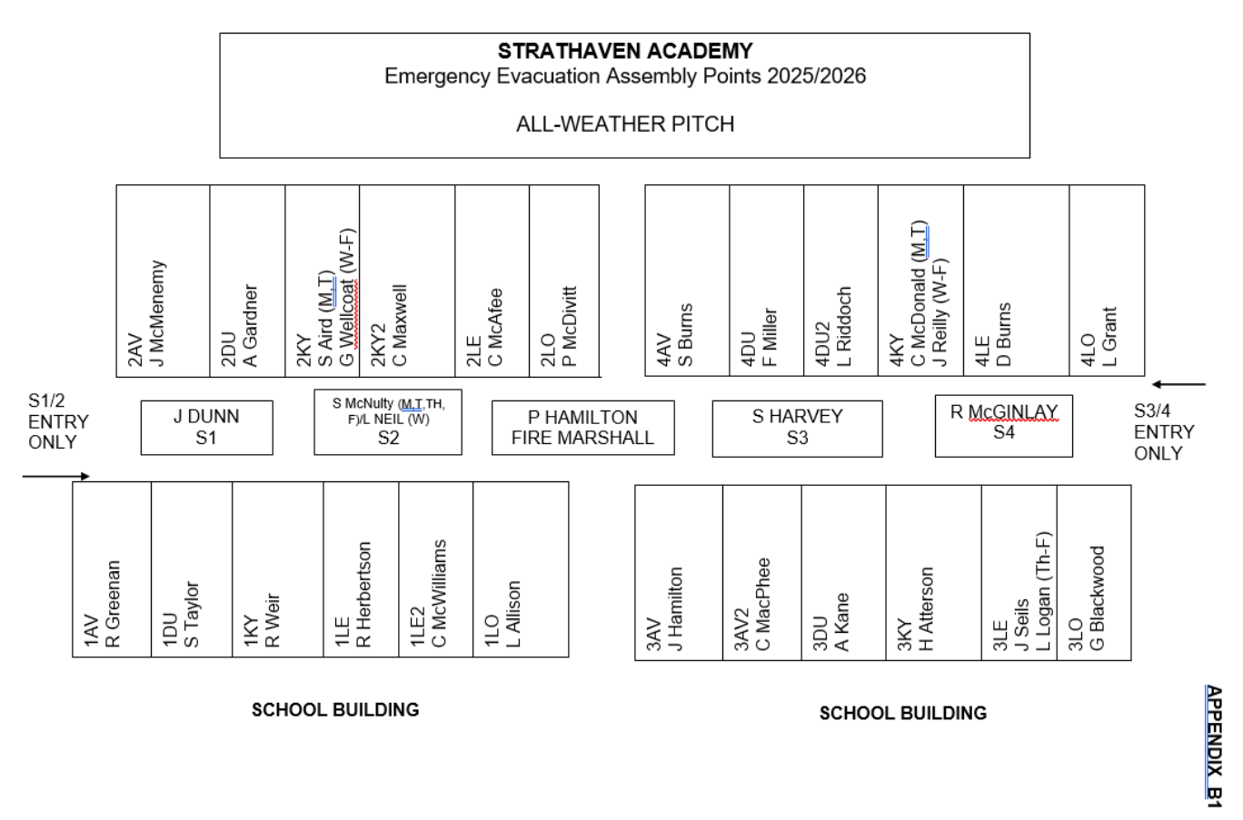
SLIDE 3

Slide 5
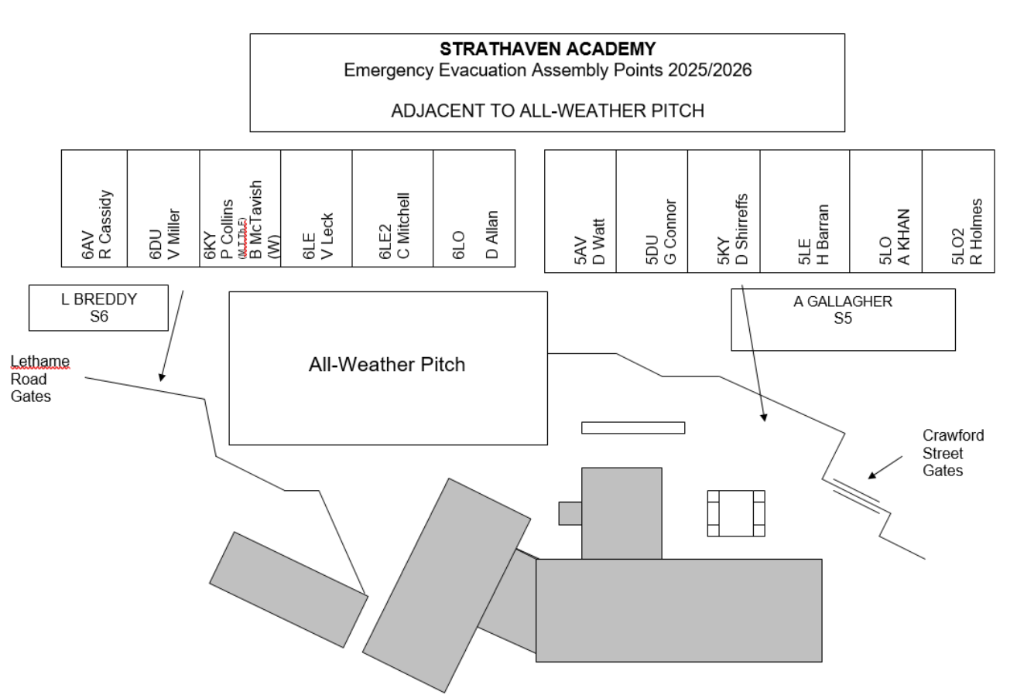
SLIDE 4

