Slide 1


Slide 2
Youth Employability
Aspire
FA
Gradu8

Slide 3
Gradu8 Offer
Available to pupils in S4-S6
Work based learning option in various frameworks
Attend College or learning provider 1 day per week to study a subject of your choice
SQA accredited qualification (SCQF Level 4 or 5)
Study alongside other subjects
Each school will be allocated either a Monday or Friday for August 2022 – Easter 2023
All Programme subjects will be from 9:30 – 2:30 on allocated day

Slide 4
Frameworks
Hair and Barber
Beauty Skills
Construction
Early Education and Childcare
Health and Social Care
Hospitality
Make-up Artistry
Engineering
Uniformed and Emergency Services (SCQF L4)
Sport and Recreation

Slide 5
Benefits of GradU8
Develop key work based learning skills in a sector of interest
Gain formal Qualifications at SCQF Level 5 (1 framework at Level 4 - U&ES)
Get a head start in growth sectors with real career opportunities
Give pupils a chance to experience college based learning
Give pupils a chance to find out more about subjects before committing to a full course
Dual accreditation with Schools through Insight

Slide 6
Where Can You Study?
  South Lanarkshire College
  New College Lanarkshire
  Other Glasgow Colleges
  External Training Providers

Slide 7
Where Does It Lead?
  Foundation Apprenticeship
  Further Education
  Modern Apprenticeships
  Employment
  Other Training Opportunities

Slide 8
How do I get more info / apply?
Speak to pupil support teacher
Follow us on Facebook – My Brighter Future
Marie McGrath
marie.mcgrath@southlanarkshire.gov.uk
07557 178 646

Slide 9
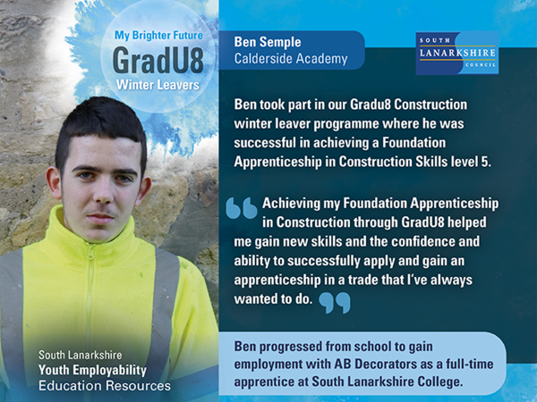

Slide 10
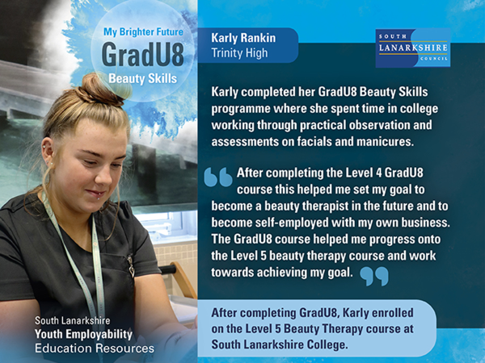

Slide 11
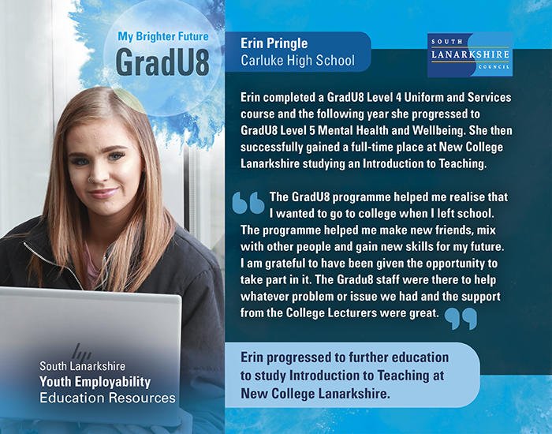

Slide 12

Gradu8 Works
Work experience placement for Senior phase pupils one day per week on the schools timetabled Gradu8 day
Placements will be available across local employers and within South Lanarkshire Council
Placement matching will be within an area of pupils choice
Aspire Vocational Development provides the pupil with ongoing support during their placement and carries out regular reviews with school, pupil and employer
All young people will be supported by the school to complete work-based qualifications
Notes:
The Gradu8 works programme allows pupils to take part in a day-a-week work experience placement which will take place on that school’s timetabled GradU8 day. This will be a Monday or a Friday.
Placements will take place between September and March in line with the mainstream G8 programme.
We have access to a wide range of placements across local employers and within South Lanarkshire Council, and South Lanarkshire Leisure and Culture.
Prior to starting the programme the pupil will be matched to a suitable placement that is within an area of interest to them,, examples of this may be within a garage, a nursery or a leisure centre.
Each pupil will be supported by a vocational development worker from the Youth Employability team who will be responsible for providing ongoing support during the placement, linking in with employers and carrying out regular reviews.
In addition to attending a work placement pupils will also be supported by the school to complete linked work-based qualifications.
In summary Gradu8 works is a really beneficial programme that allows pupils to gain work experience with local employers, they will be able to develop important transferable skills and gives a real insight into the world of work.

Slide 13
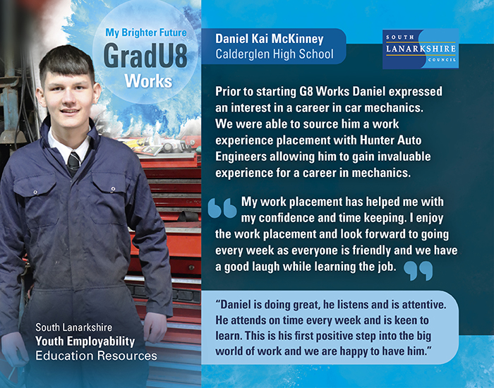

Slide 14
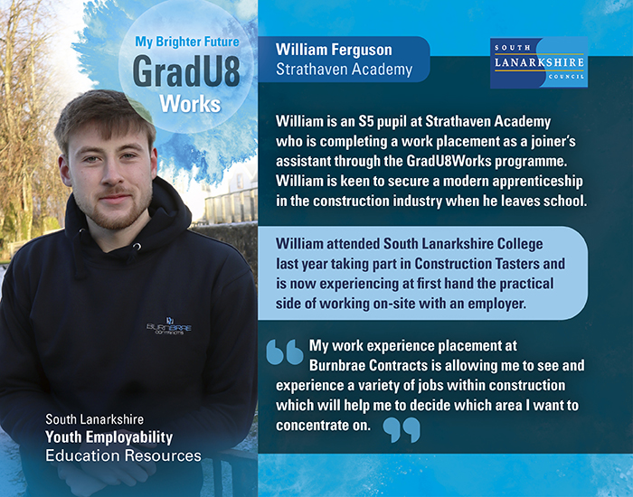

Slide 15
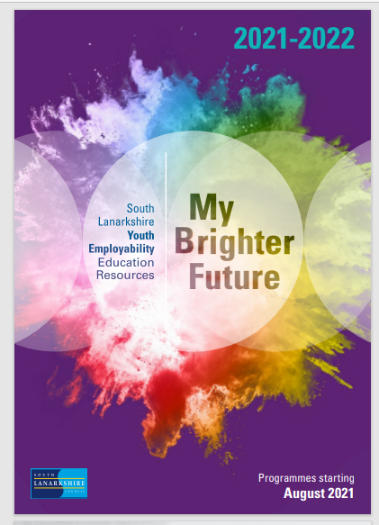
For more information
To request a copy of our new brochure email us at :- youth.employability@southlanarkshire.gov.uk
www.apprenticeships.scot
www.skillsdevelopmentscotland.co.uk

Slide 16


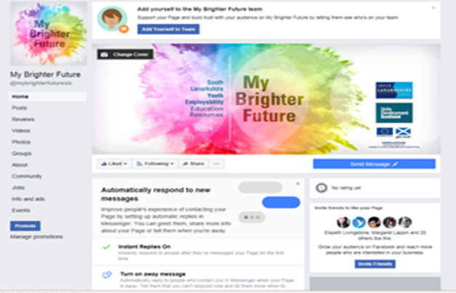

Follow us on Facebook and Twitter
@my8rightfuture
My Brighter Future

