Slide 1


Slide 2
Youth Employability
Aspire
FA
Gradu8

Slide 3
What is a Foundation Apprenticeship?
Work-based learning option for pupils in S5-S6
Study alongside other subjects
Spend some time each week out of school, learning at college/High School Hub and in a real workplace
SQA accredited qualification (SCQF Level 6) - same level as a higher
Learn essential skills employers want and strengthen your CV or personal statement
Recognised by all Scottish universities and colleges

Slide 4
Frameworks
Accountancy
Business Skills
Civil Engineering
Creative and Digital Media
Engineering
Financial Services
Food and Drink Technologies
Hardware and System Support
Scientific Technologies
Social Services Children and Young People
Social Services and Healthcare
Software Development

Slide 5
How Does It Work?
Students choose an FA as one of their subject choices.
Option to complete over 1 or 2 years.
Students will attend their FA on a Tuesday and Thursday
Students will spend time in the classroom working towards a National Progression Award or National Certificate.
Students will also spend time in a real work place gaining practical skills and part of a Scottish Vocational Qualification (SVQ) or new SDS Customised units.
Alongside the FA students will be working towards national and higher qualifications at school.

Slide 6
Where Can You Study?
South Lanarkshire Consortium
Glasgow College Consortium
West Lothian College

Slide 7
Where Can It Lead?
Modern Apprenticeship
Graduate Apprenticeship
University
College
Employment

Slide 8


Slide 9
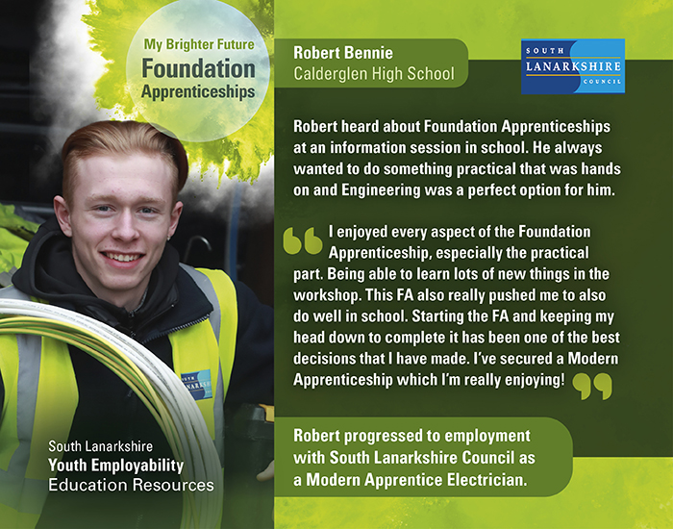

Slide 10
How do I get more info / apply?
Speak to pupil support teacher
Applications made - supported by pupil support teacher
South Lanarkshire Consortium
Foundation Apprenticeships - South Lanarkshire College (south-lanarkshire-college.ac.uk)
Glasgow Consortium
Foundation Apprenticeship Glasgow (fapglasgow.scot)

Slide 11
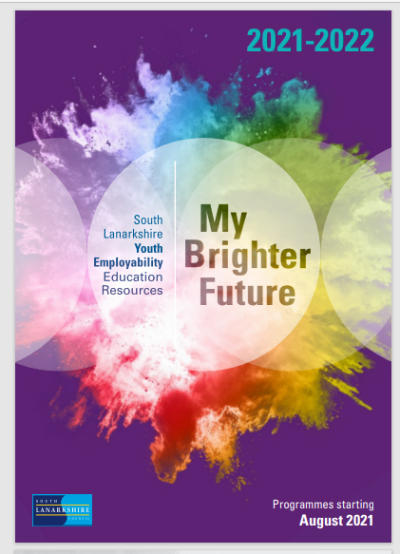
For more information
To request a copy of our new brochure email us at :- youth.employability@southlanarkshire.gov.uk
www.apprenticeships.scot
www.skillsdevelopmentscotland.co.uk

Slide 12


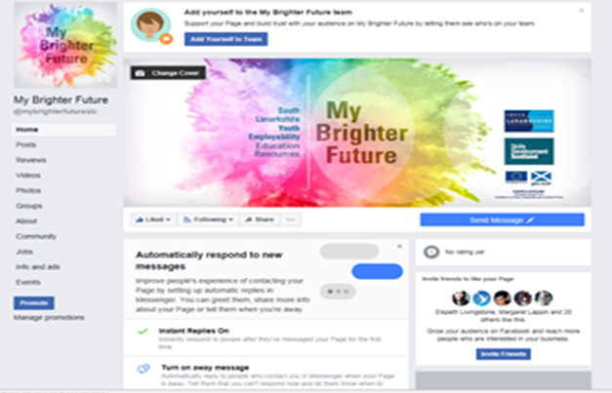

Follow us on Facebook and Twitter
@my8rightfuture
My Brighter Future

