Slide 1
Click this icon on each slide to return to this homepage.
Administration & Management Health & Medicine
Animals, Land & Environment Hospitality, Leisure & Tourism
Art & Design Housing, Property & Facilities
Arts, Social Sciences & Languages Information, Culture & Heritage
Buying, Selling & Related Work Law
Communications and Media Manufacturing Industries
Computing & ICT Performing Arts
Construction Science & Maths
Engineering Social, Caring & Advisory Services
Finance Sport
Garage Services Teaching & Classroom Support
Hairdressing, Beauty & Wellbeing Transport & Distribution
Uniformed & Security Services

Slide 5
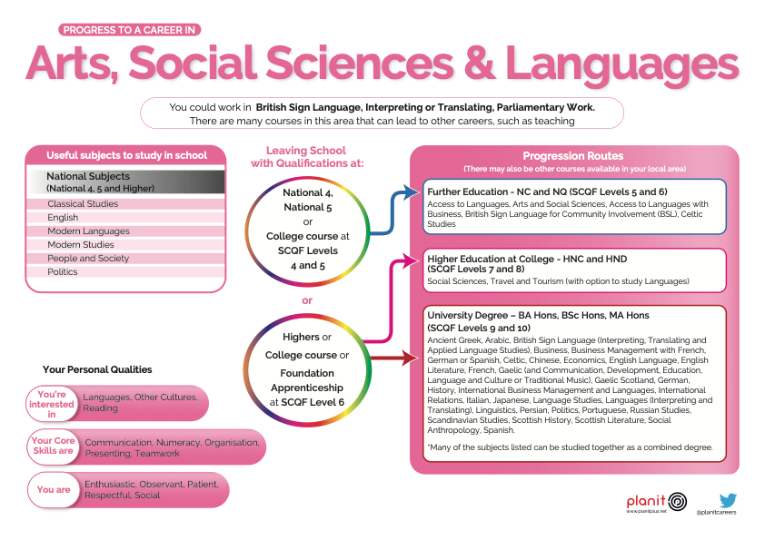

Slide 7
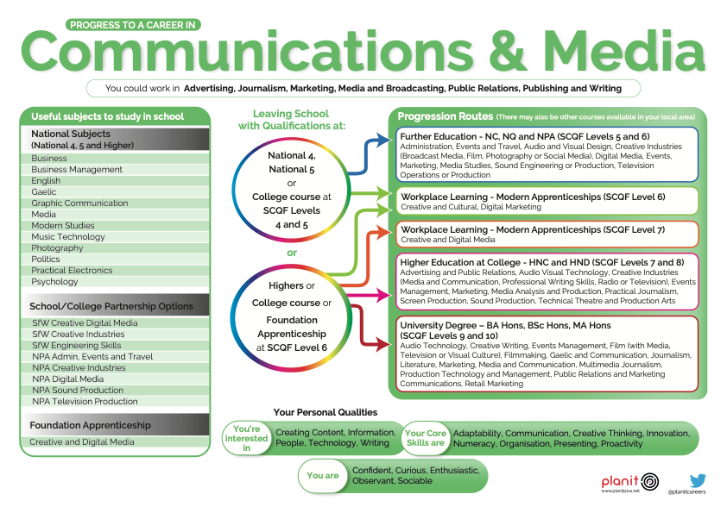

Slide 8
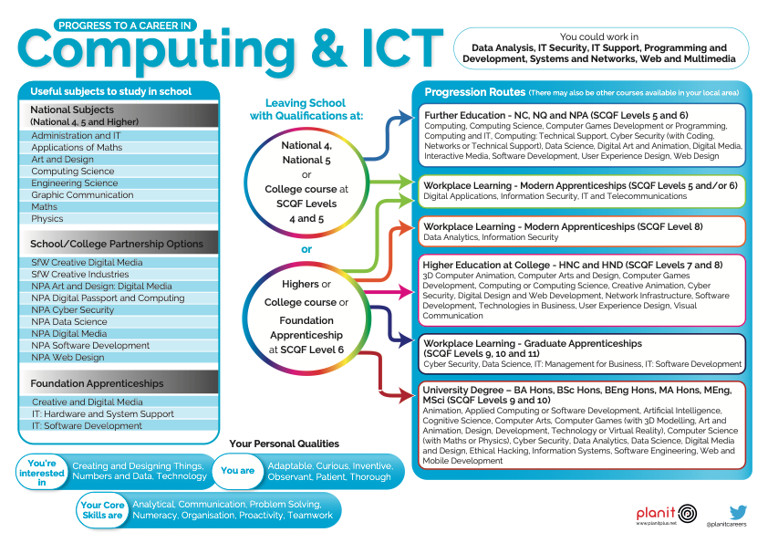

Slide 10
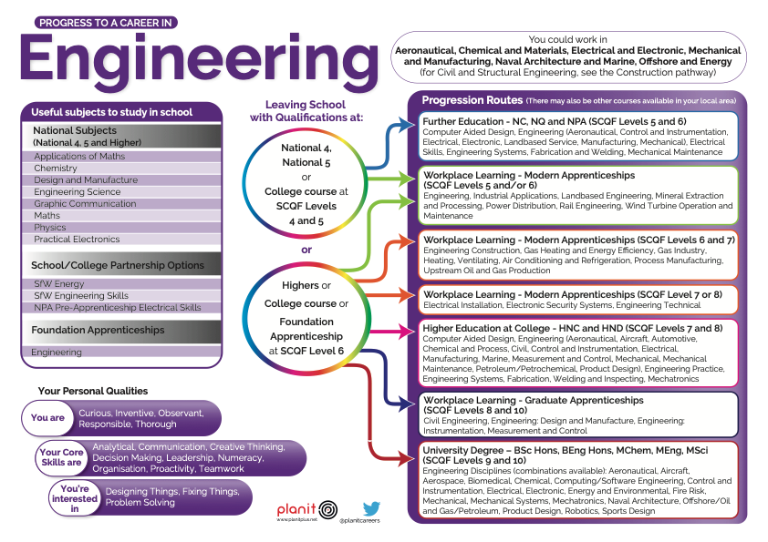

Slide 11
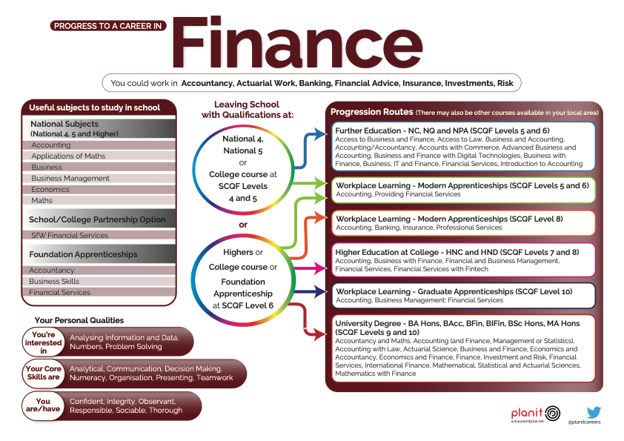

Slide 18
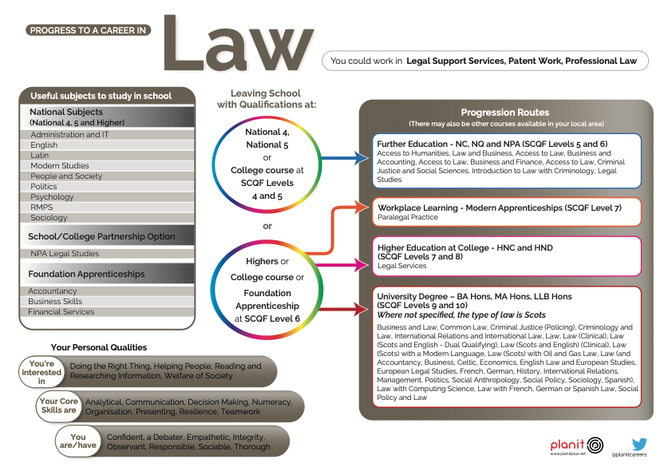

Slide 20
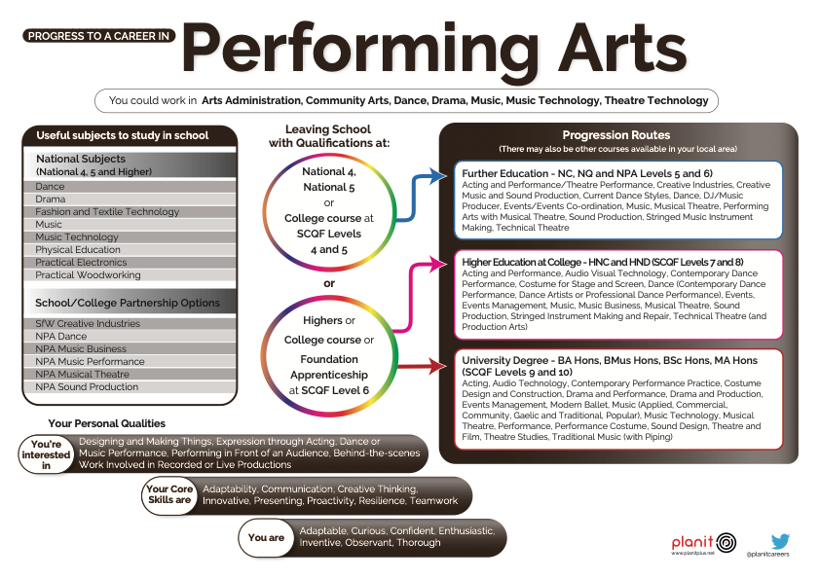

Slide 21
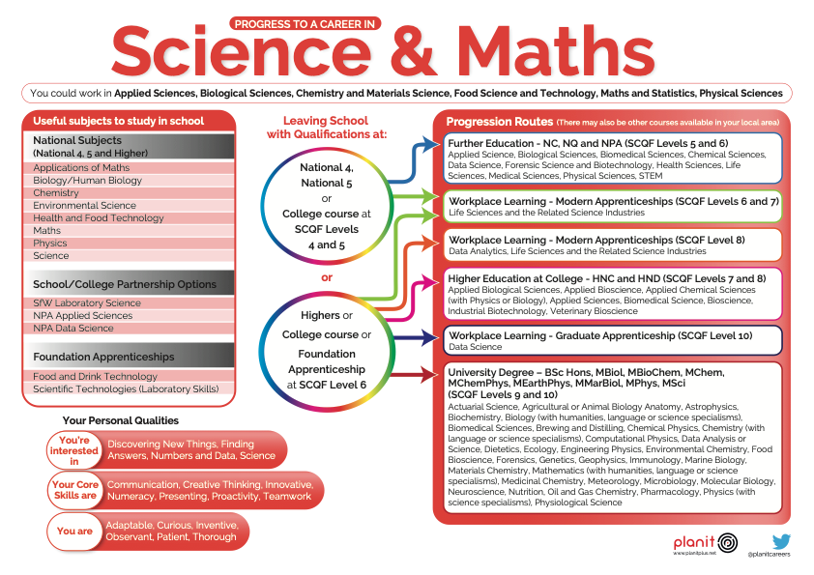

Slide 24
