Slide 1
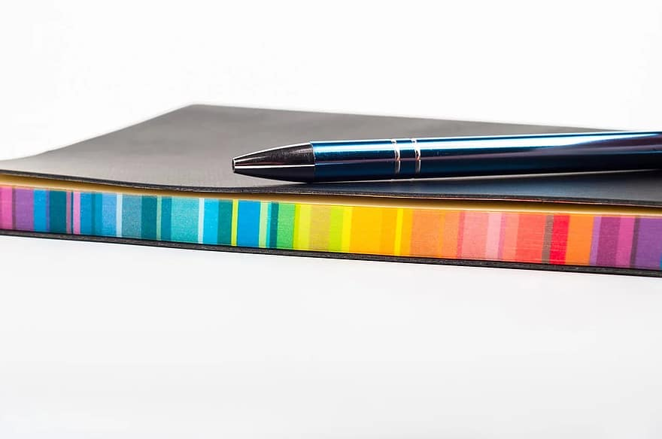
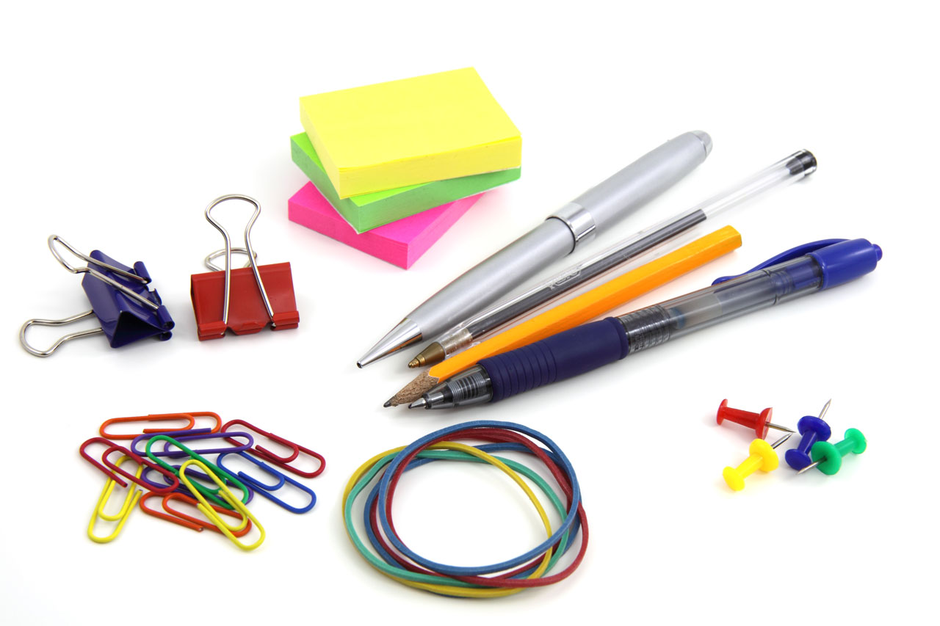
Notes and Flashcards
Study Skills

Slide 2
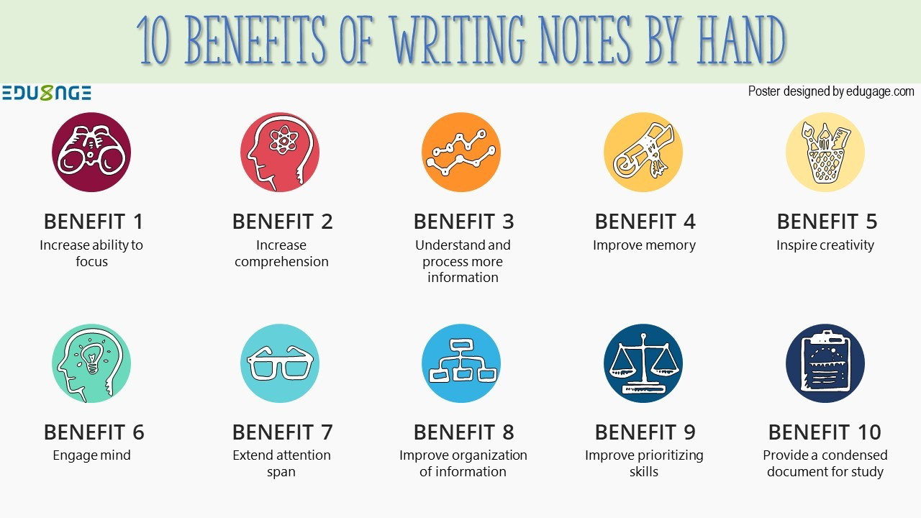
Why Use Notes and Flashcards?
Most of the time just re-reading your notes isn’t enough for you to really learn the information.
Re-writing coursework in the form of notes and flashcards allows you to repeat information in a way that will be much more effective for memorising information.
Notes and flashcards are very simple and easy study methods: they don’t require great artistic skills and they are a great way to organise coursework in a way that better suits you.

Slide 3
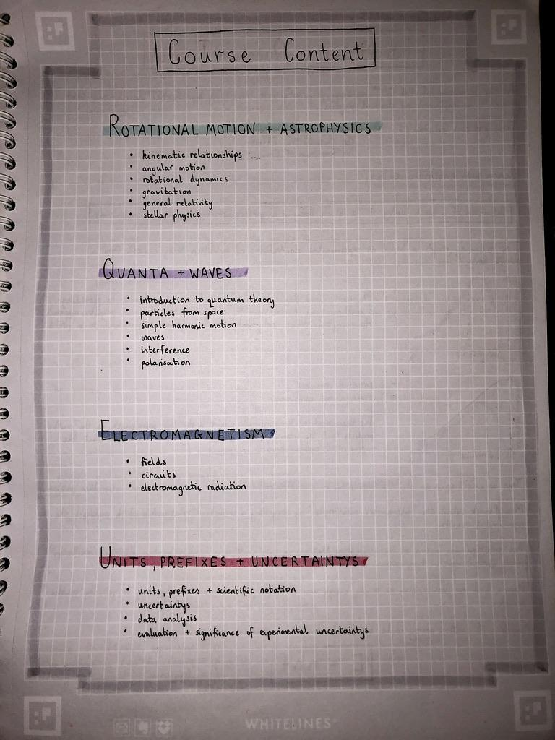
Writing Effective Notes
Use SQA course specifications to organise and structure your notes effectively.
Have a plan before each study session with:
How much you plan to do
What you plan to cover
How you are going to write your notes
Remember not to try to do too much in each study session: keep a manageable workload that you will be able to maintain.

Slide 4
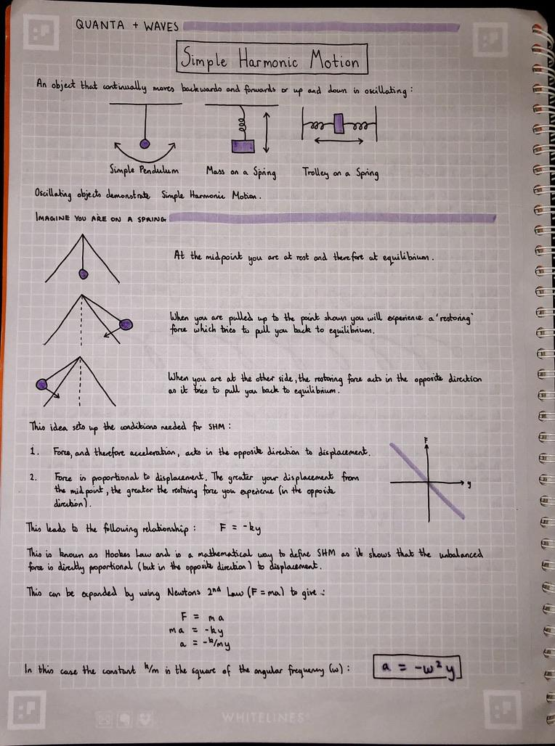
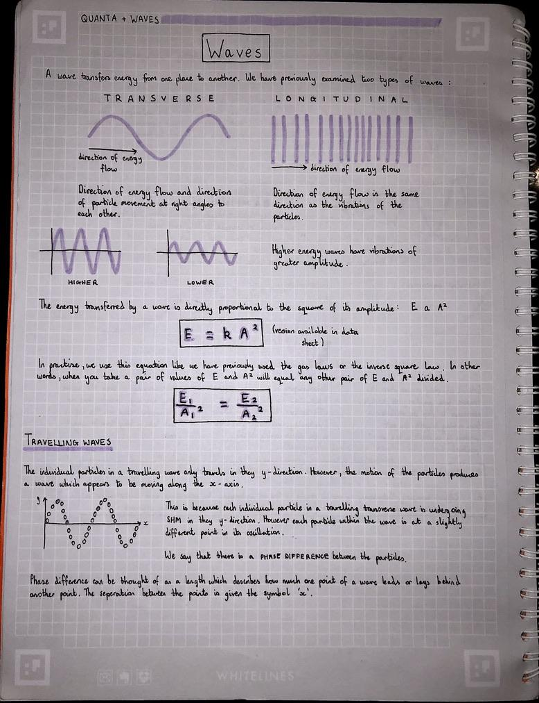
Note Techniques
Coordinate highlighter colours to different units/subtopics/areas of the course.
Use diagrams and tables as visual aids to summarise information into an easier-to-manage form.
Don’t just write exactly what your teacher’s notes say: change the words or format into a way which is easier for you to understand.

Slide 5
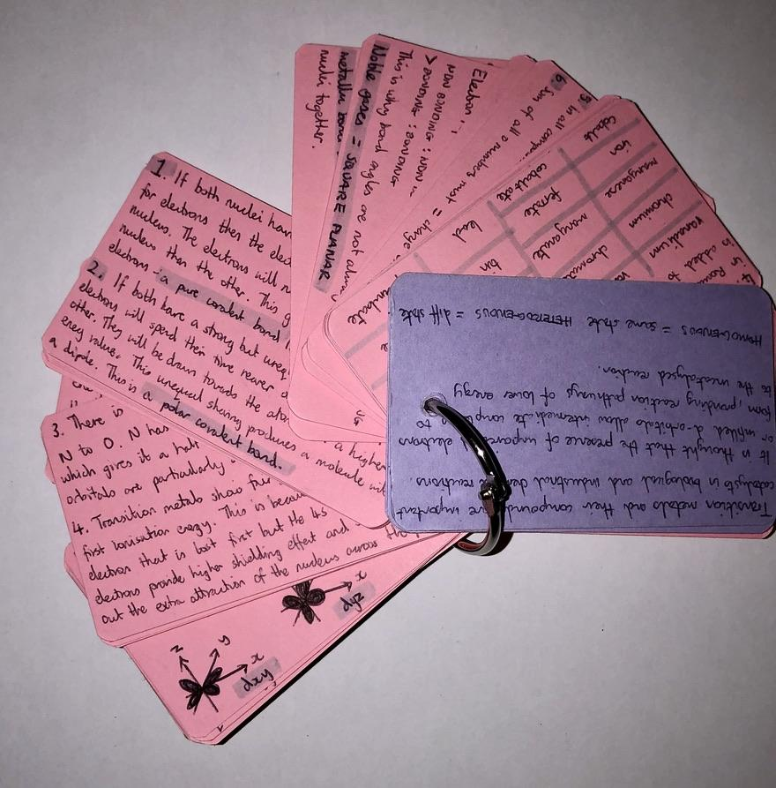
Using Flashcards: Method 1
Flashcards can be used in a very similar way to written notes.
You may choose to write your notes on flashcards rather than in notebooks as they are easier to transport and can be flicked through very quickly.
For this method use the structure and techniques given on the previous slides, following the same format as you would for normal notes.

Slide 6
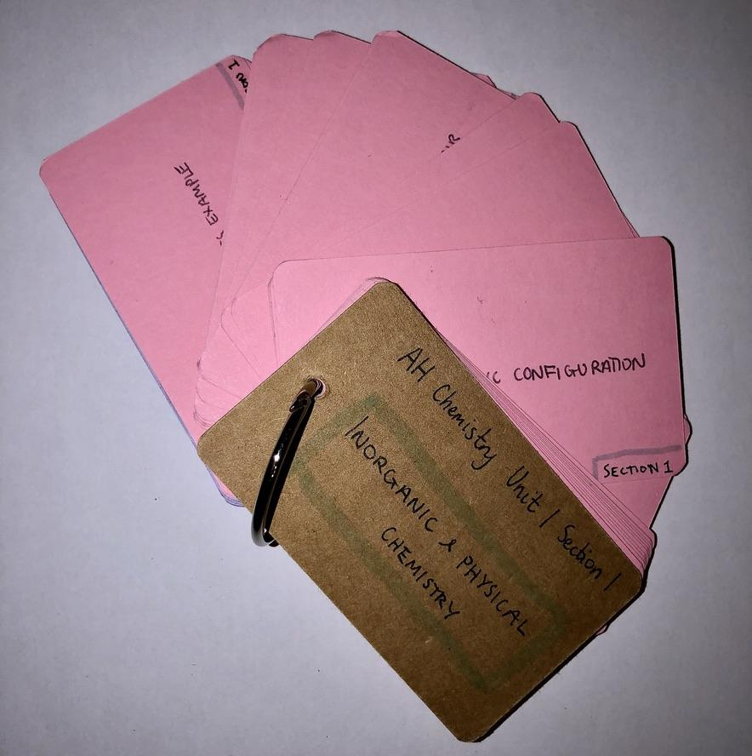
Using Flashcards: Method 2
The second method for using flashcards is to make question cards.
These are great for learning definitions, vocab or key course information.
Write a question on one side of the card and the answer on the other.
Testing yourself regularly using these cards will help you memorise important information for assessments, prelims or exams.

Slide 7
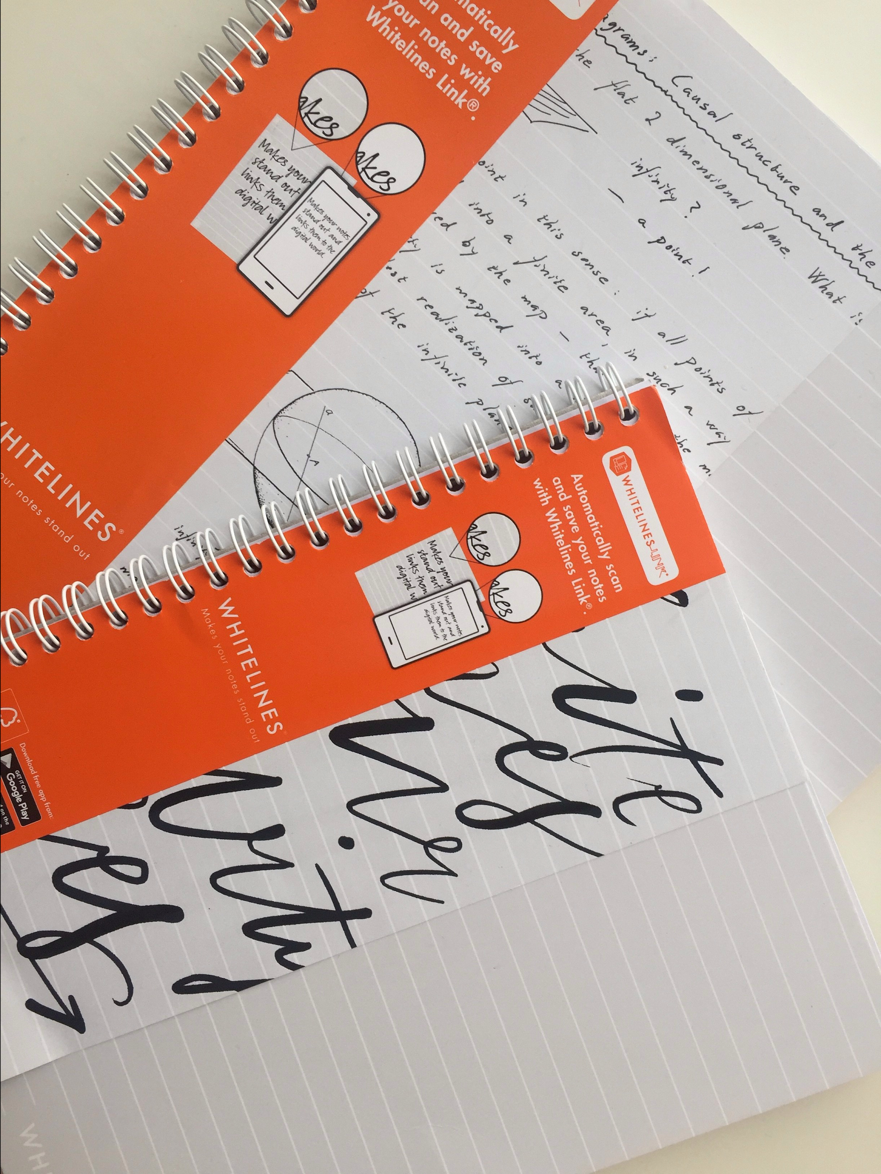
Study Supplies
You really only need some paper and a pen to write any notes or flashcards but having nice supplies can help motivate you to study.
For notebooks I like Whitelines which you can find on Amazon- the notepads are attached to an app.
You can find hundreds of different types of flashcards on Amazon as well, I prefer flashcard binders as they help me keep my cards together.
Alternatively, the app, Quizlet, allows you to make electronic flashcards.

Slide 8
My Number 1 Tip
Try and gradually build throughout the year: try hard in homeworks, revise for tests and listen in class. The more work you do throughout the year, the easier it will be to prepare for exams.

