Slide 1
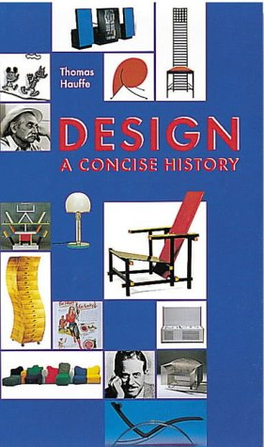
Design
Examples from Historical
WHAT IS DESIGN?
Early history (1750 – 1850)
The industrial revolution (1830 – 1880)
Reform movements (1850 – 1914)
The road to modernism (1890 – 1914)
Revolution and the avande garde (1915 – 1933)
Luxury and power (1925 – 1945)
The economic miracle (1945 – 1960)
Good form and bel design (1954 – 1968)
Experimentation and antidesign (1965 – 1976)
Postmodernism (1968 – )
Contemporary design
FUNCTION
FABRICATION
FORM
FANTASY

Slide 2
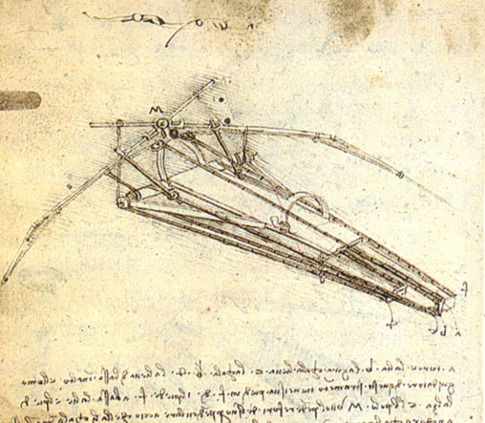
WHAT IS DESIGN?
FORM
FUNCTION
FABRICATION
FANTASY
STUDY FOR A FLYING MACHINE
(1452 - 1519)
LEONARDO DA VINCI
p11
WHAT IS DESIGN? (P10)

Slide 3
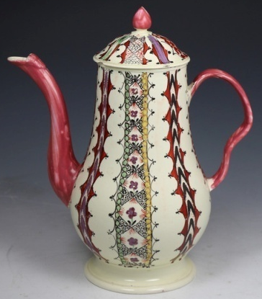
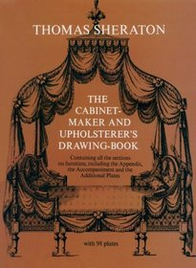
EARLY HISTORY (1750 -1850)
The transition of handwork to production. Furniture pattern books were produced to secure orders in advance. Design had early acquired significance not only for production but for sales .
PRODUCTION
ANTIQUE ENGLISH CREAMWARE CHINTZ PATTERN COFFEE POT.
(1770) 24 cm high
JOSIAH WEDGEWOOD
p11
EARLY HISTORY 1750 – 1850 (P20)

Slide 4
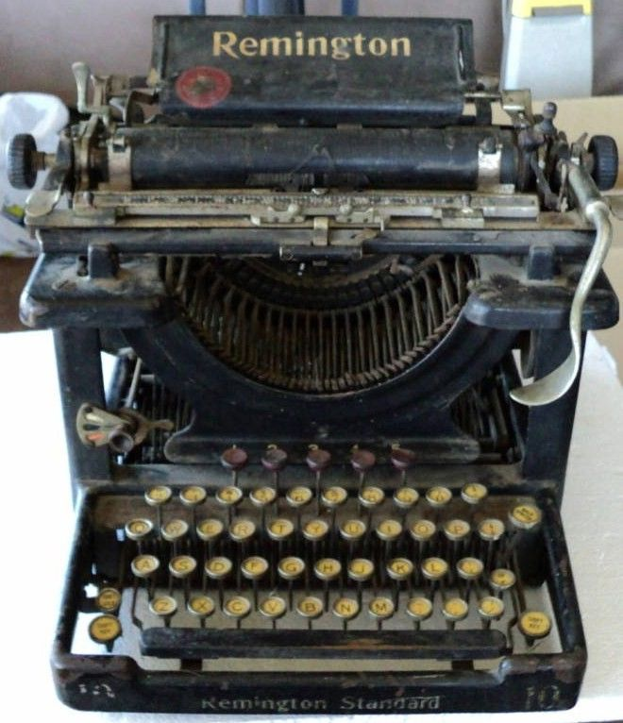
THE INDUSTRIAL REVOLUTION (1830 – 1880)
In 1765 James Watt invented the steam engine. As a result, coal mining, iron and steel production took on new significance. It led to industrial mass production, modern transportation systems and the growth of cities.
The increasing mechanization that accompanied industrialization encompassed not only production methods, but the products themselves.
THE
INCANDESCENT
LIGHT BULB
(1875-76)
THOMAS EDISON
p31
THE REMINGTON NO. 1
(1876)
REMINGTON AND SONS
p30
THE INDUSTRIAL REVOLUTION 1830 – 1880 (P28)

Slide 5
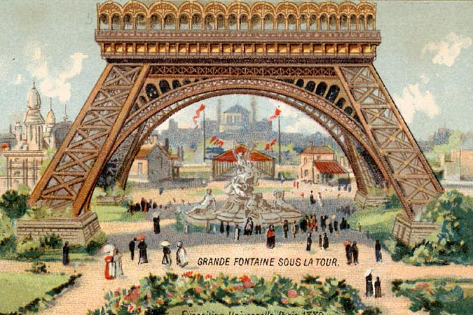
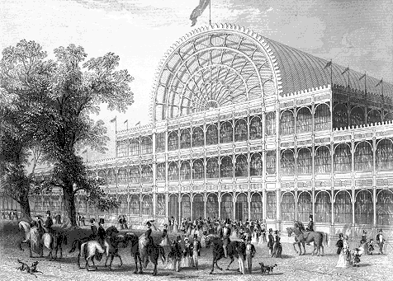
THE INDUSTRIAL REVOLUTION (1830 – 1880)
THE CRYSTAL PALACE
(BUILT FOR THE LONDON ‘GREAT EXHIBITION’ OF 1851)
JOSEPH PAXTON
p35
WORLD EXHIBITIONS
EIFFEL TOWER
(BUILT FOR PARIS EXPOSITION OF 1889)
ALEXANDRE GUSTAVE EIFFEL
p35
THE INDUSTRIAL REVOLUTION 1830 – 1880 (P28)

Slide 6
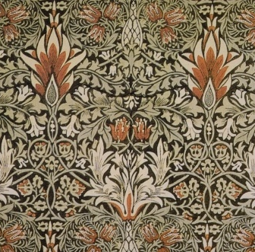
REFORM MOVEMENTS
ARTS AND CRAFTS MOVEMENT
CLOTH DESIGN
COTTON, HAND PRINTED
WITH NATURAL DYES
(1876)
WILLIAM MORRIS
p41
REFORM MOVEMENTS 1850 - 1914 (P 38)

Slide 7
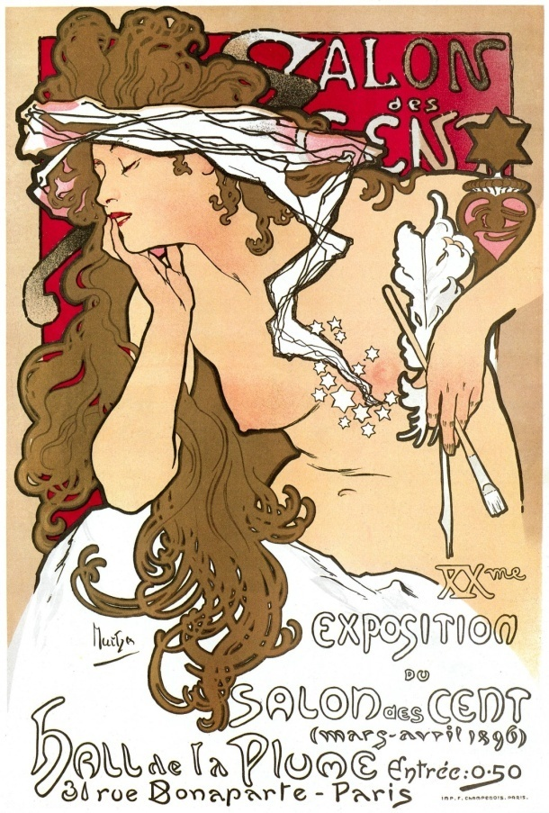
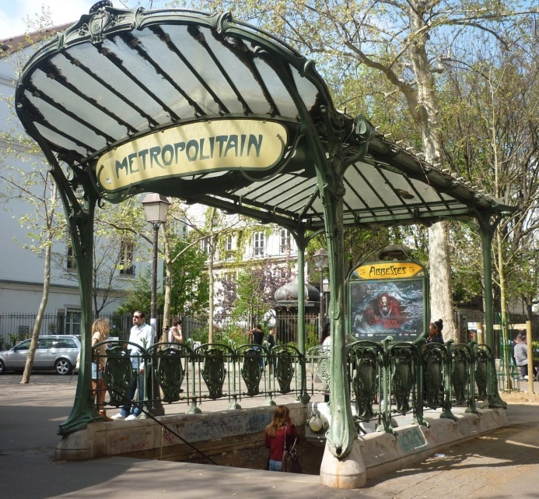
REFORM MOVEMENTS
ENTRANCE TO PARIS METRO STATION
CAST IRON (PREFABRICATED) GLASS
(1900)
HECTOR GUIMARD
p47
ART NOUVEAU
SALON DE CENT LITHOGRAPH
(1896)
ALPHONSE
MUCHA
REFORM MOVEMENTS 1850 - 1914 (P 38)

Slide 8
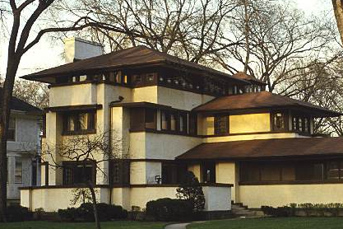
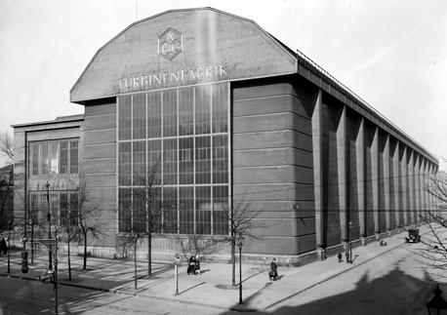
THE ROAD TO MODERNISM
‘Ornament is a waste of the energy and labour, and therefore a waste of health. …Today it also means squandered material, and squandered capital….The modern person, the person with modern nerves, does not need ornament, on the contrary, he detests it.’
Adolf Loos, 1908
‘It is precisely in electrical technology that is important not to mask forms behind decorative additions, but because the technology is a completely new area, to find forms that represent the new character of the technology.’
Peter Behrens , 1910
AEG logo progression from Franz Schwechten in 1896 to Peter Behrens in 1912
AEG TURBINE
HALL
(1909)
PETER BERENS
BERLIN,
GERMANY p63
OAK PARK HOUSE
(1903)
FRANK LLOYD WRIGHT
ILLINOIS, USA p59
THE ROAD TO MODERNISM 1890 – 1914 (P 54)

Slide 9
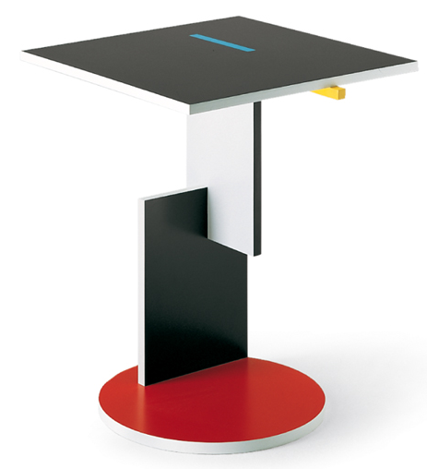
REVOLUTION AND THE AVANDE GARDE
‘SCHLAGT DIE WEISSEN…’ POSTER
(1920)
EL LISSITSKY
p67
SIDE TABLE
LAQUERED WOOD (MODERN REPRODUCTION)
(1922-3)
GERRIT REITVELD
p70
REVOLUTION AND THE AVANDE GARDE 1915 – 1933 (P 64)

Slide 10
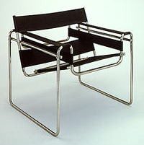
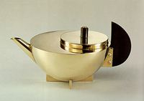
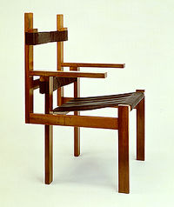
REVOLUTION AND THE AVANDE GARDE
‘…Architects, painters and sculptors must once again come to know and comprehend the composite character of a building, both as entity and in terms of it’s various parts…(lifting the) barrier between craftsmen and artists!...It will combine architecture, sculpture and painting in a single form’
WALTER GROPIUS
TUBULAR STEEL CHAIR
NICKEL-PLATED TUBULAR STEEL,
IRON THREAD FABRIC
(1926)
MARCEL BRUER
p77
THE BAUHAUS
TEA-EXTRACT POT
BRASS, SILVER, EBONY
(1924)
MARIANNE BRANDT
P76
CHAIR FROM WOODEN SLATS
(1923)
MARCEL BREUER
p75
REVOLUTION AND THE AVANDE GARDE 1915 – 1933 (P 64)

Slide 11
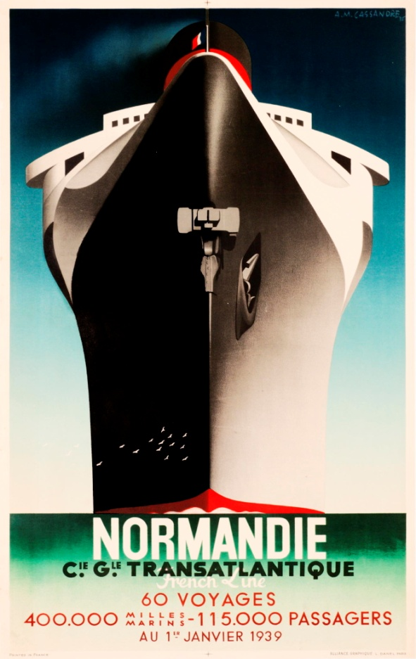
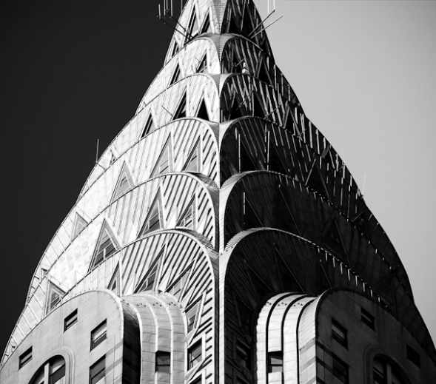
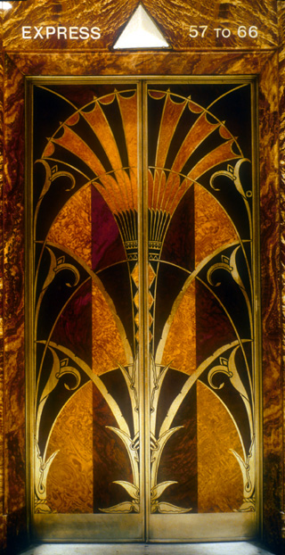
LUXURY AND POWER
NORMANDIE
(1935)
A.M CASSANDRE
POSTER
p87
ART DECO
CHRYSLER BUILDING TOWER DETAIL (ABOVE) AND
INTERIOR ELEVATOR (MIDDLE)
(1930)
WILLIAM VAN ALEN
P94, 95
LUXURY AND POWER 1925 - 1945 (P86)

Slide 12
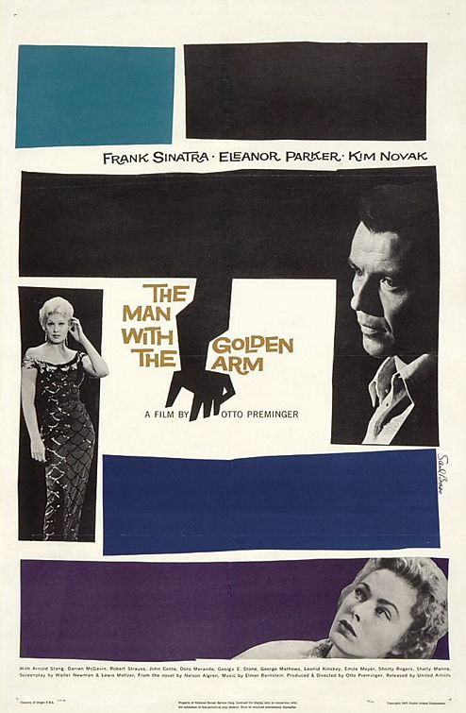
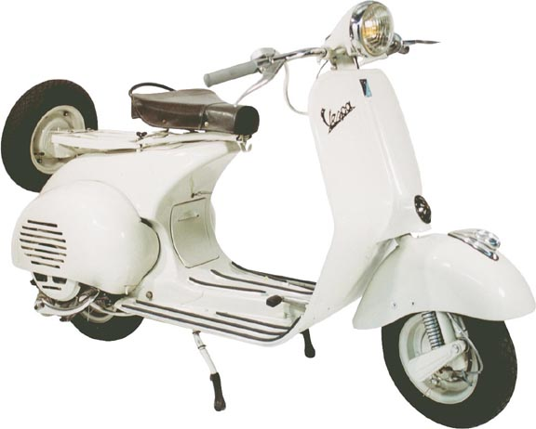
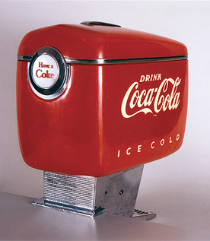
THE ECONOMIC MIRACLE
COCA COLA SODA DISPENSER
(1947)
RAYMOND LOEWY ASSOCIATES
p111
VESPA
(1955)
(FIRST MODEL DESIGNED BY) CORRADINO D’ASCANIO
p112
THE MAN WITH THE GOLDEN ARM
(1945)
SAUL BASS
THE ECONOMIC MIRACLE 1945 - 1960 (P 104)

Slide 13
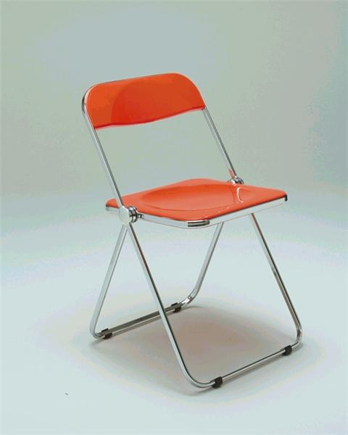
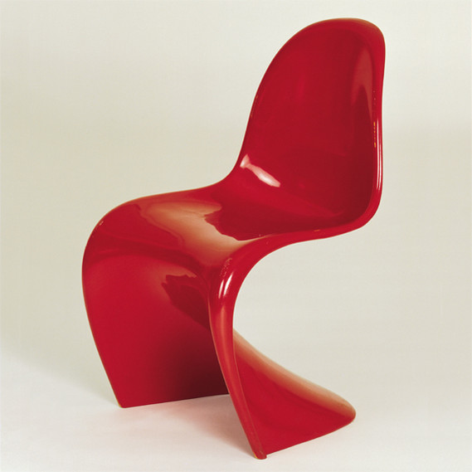
GOOD FORM AND BEL DESIGN
THE FOLDING CHAIR
(1969)
GIANCARLO PIRELLI
p135
SIDE CHAIR/ PANTON CHAIR
(1968)
VERNER PANTON
p137
New man-made materials in furniture construction.
Polypropylene, polyurethane, polyester, polystyrol.
Furniture can be produced entirely by machine in any colour; these materials are fully malleable, light, cheap, and ‘modern’.
GOOD FORM AND BEL DESIGN 1954 – 1968 (P 128)

Slide 14
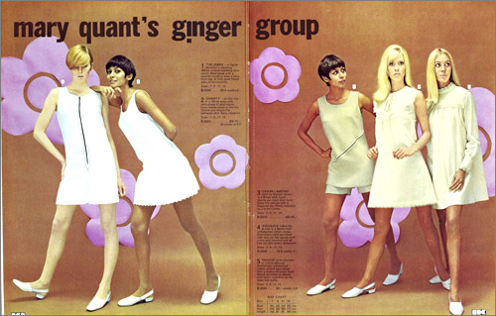
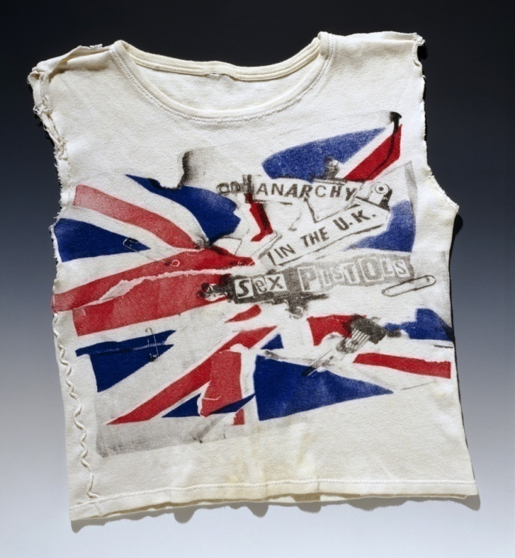
EXPERIMENTATION AND ANTIDESIGN
‘The inadequacy of the purely purpose-oriented form is revealed for what it is-a monotonous, impoverished boring practicality’
Theodore W. Adorno
POPCULTURE TO ANTI-FASHION
MINI DRESS
(1966)
MARY QUANT
p144
T-SHIRT
(customised by Johnny Rotten)
VIVIENNE WESTWOOD/ JAMIE REID
(1970’s)
EXPERIMENTATION AND ANTIDESIGN 1965 – 1976 (P140)

Slide 15
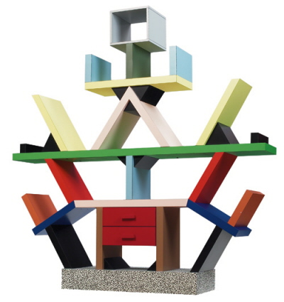
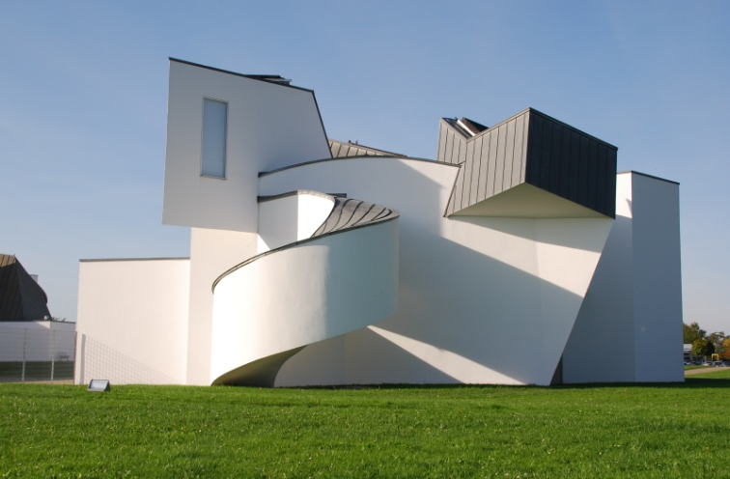
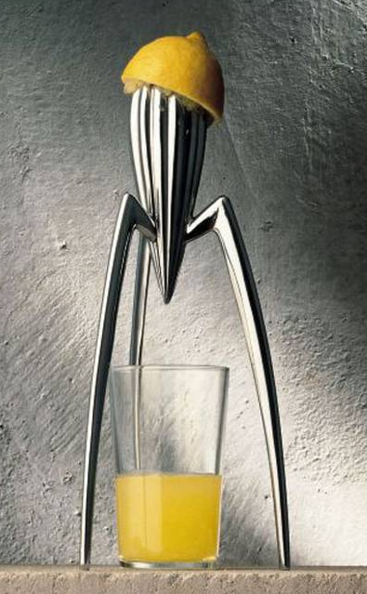
POST MODERNISM
‘LEMON PRESS, JUICY SALIF’
(1990)
PHILIPPE STARK
p165
VITRA DESIGN MUSEUM
(1989)
FRANK O. GEHRY
p173
‘CARLTON SHELVES’
(1981)
ETTORE SOTTSASS
p155
POST MODERNISM 1968 – PRESENT (P148)

Slide 16
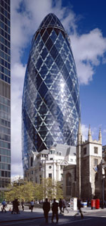
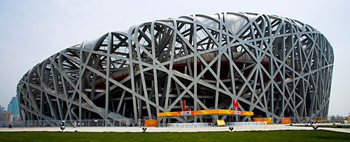
CONTEMPORARY DESIGN
‘BEIJING NATIONAL STADIUM’ (‘BIRDS NEST’)
(2008)
JACQUES HERZOG AND PIERRE DE MEURON
‘BURJ AL ARAB’
(1994-99)
TOM WRIGHT
‘30 ST MARY AXE’ (‘THE GERKIN’)
(2003)
NORMAN FOSTER
POST MODERNISM 1968 – PRESENT (P148)

Slide 17
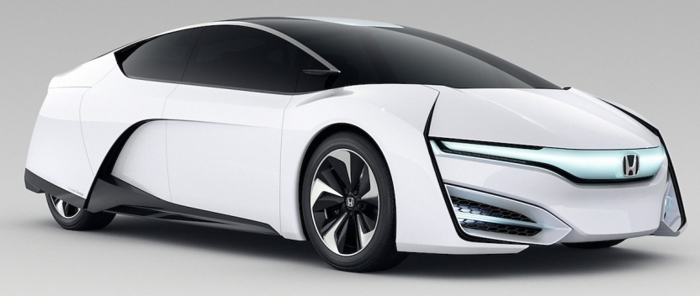
CONTEMPORARY DESIGN
‘THE WAY AHEAD, AUDI’ (2013)
DAVID CARSON
‘VULNICURA’ (BJORK ALBUM COVER)
(2015)
Photography INEZ LAMSWEERDE and VINOODH MATADIN, Design M/M PARIS
‘CONCEPT DESIGN - HONDA’
(2015)
POST MODERNISM 1968 – PRESENT (P148)
FORM FUNCTION FABRICATION FANTASY

